Slide 1
Are charging stations put on the right spot?
1 – looking at current locations of charging stations

Slide 2
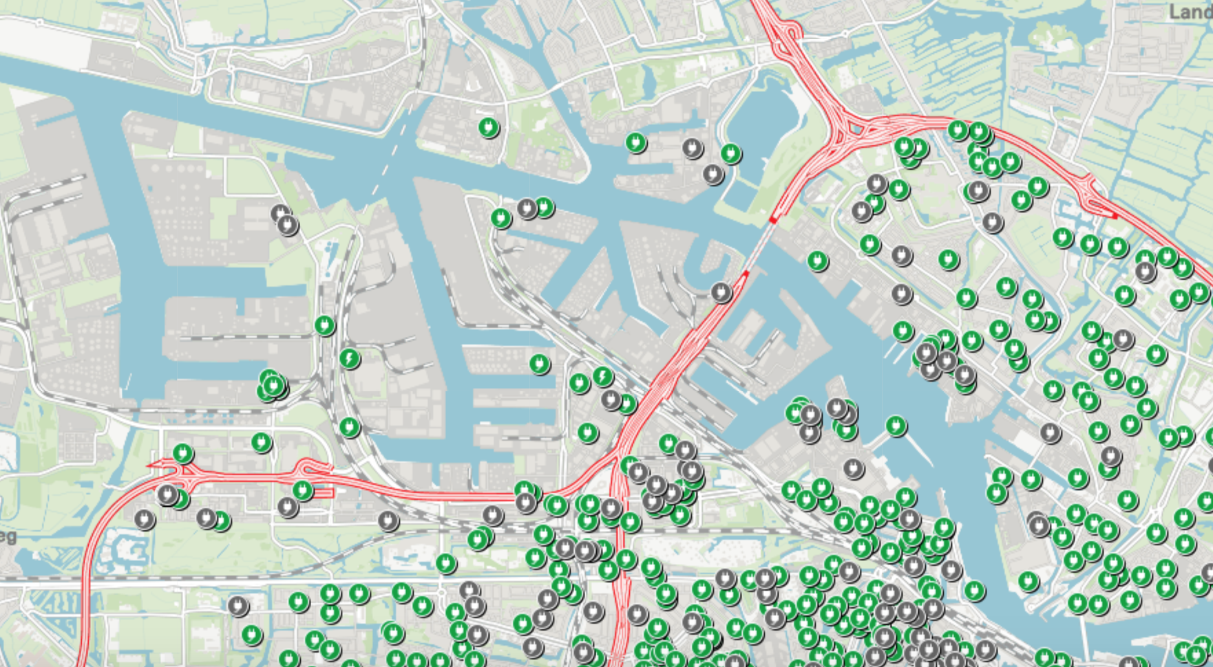
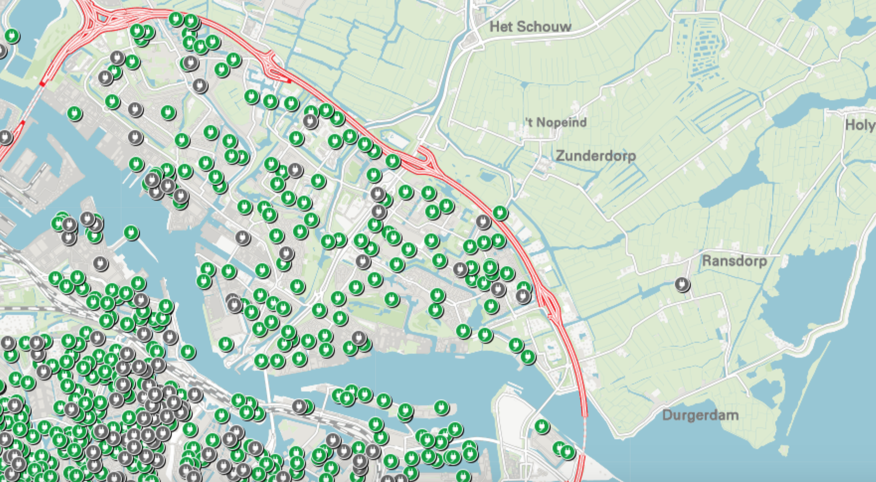
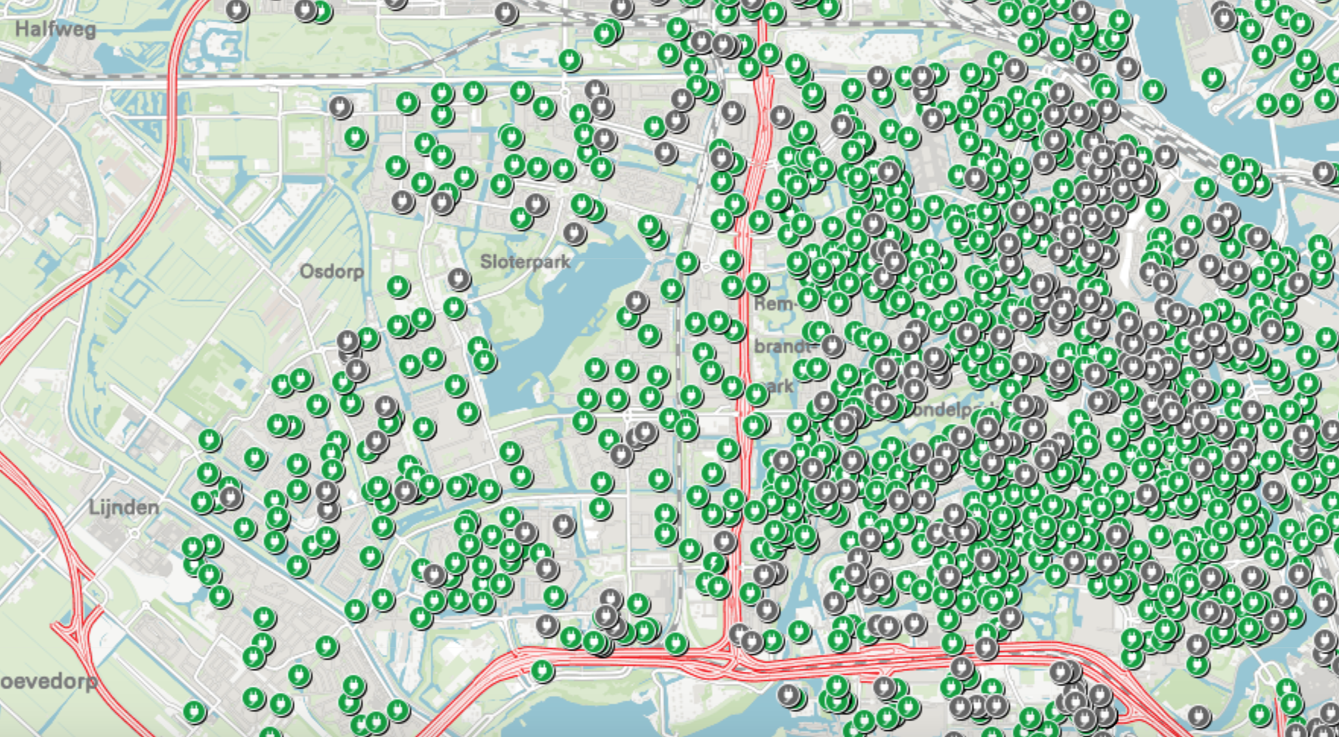
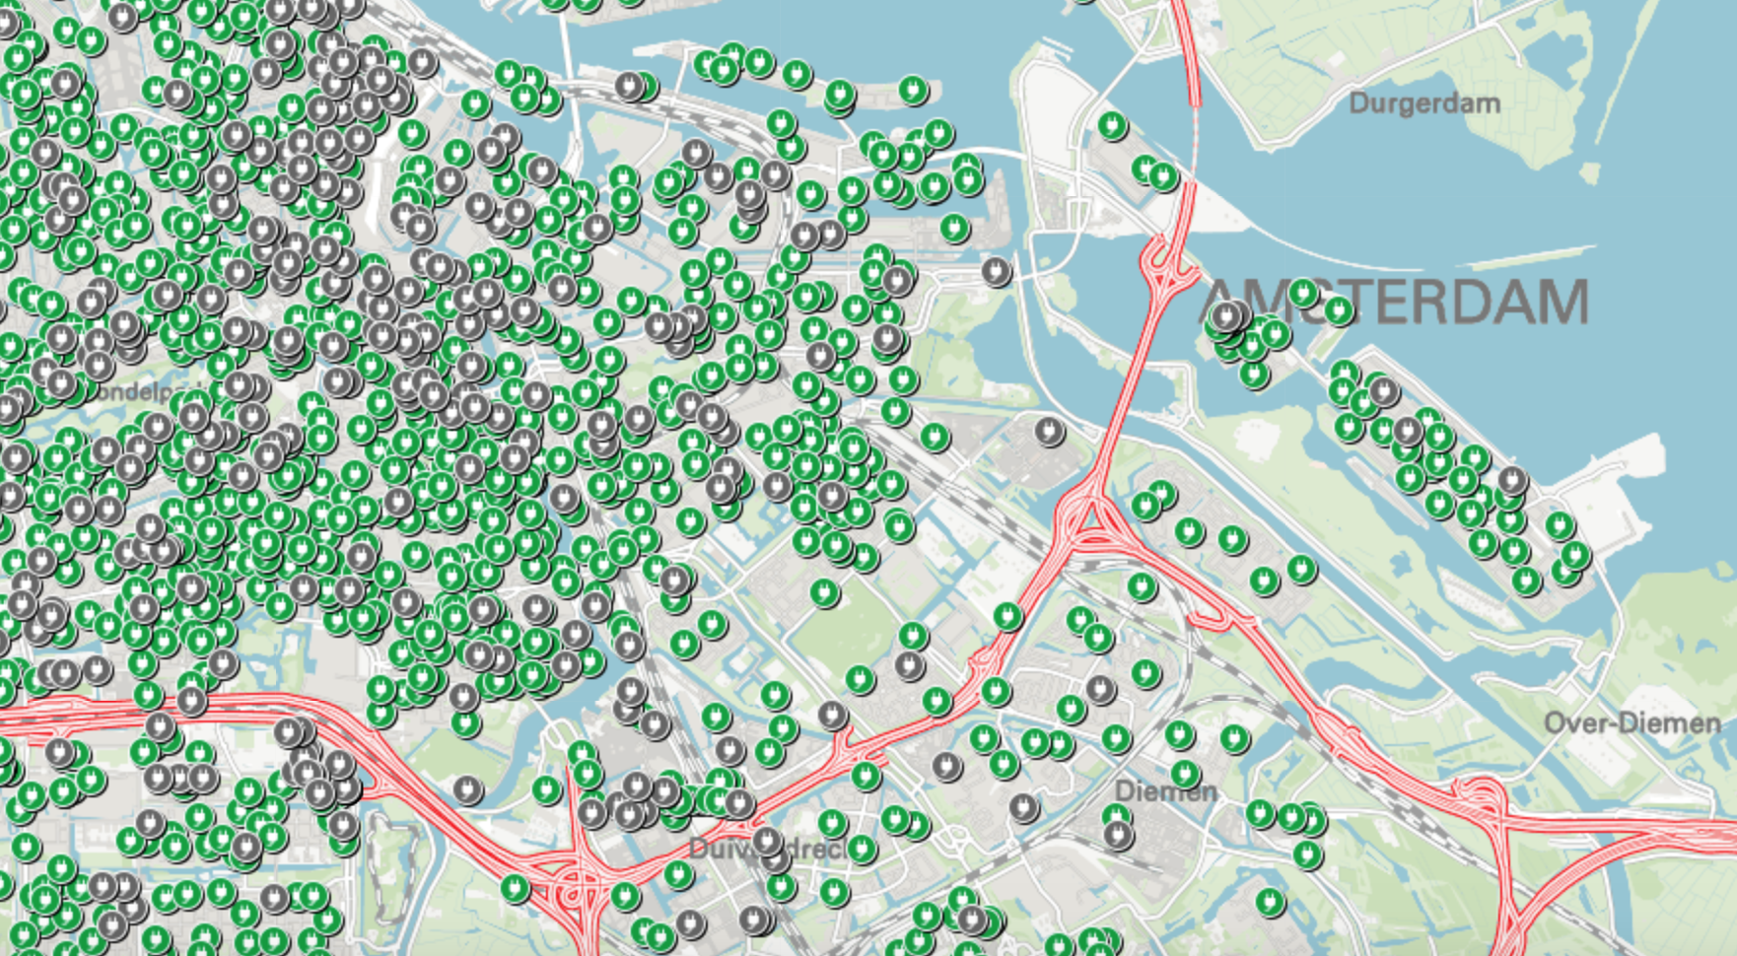
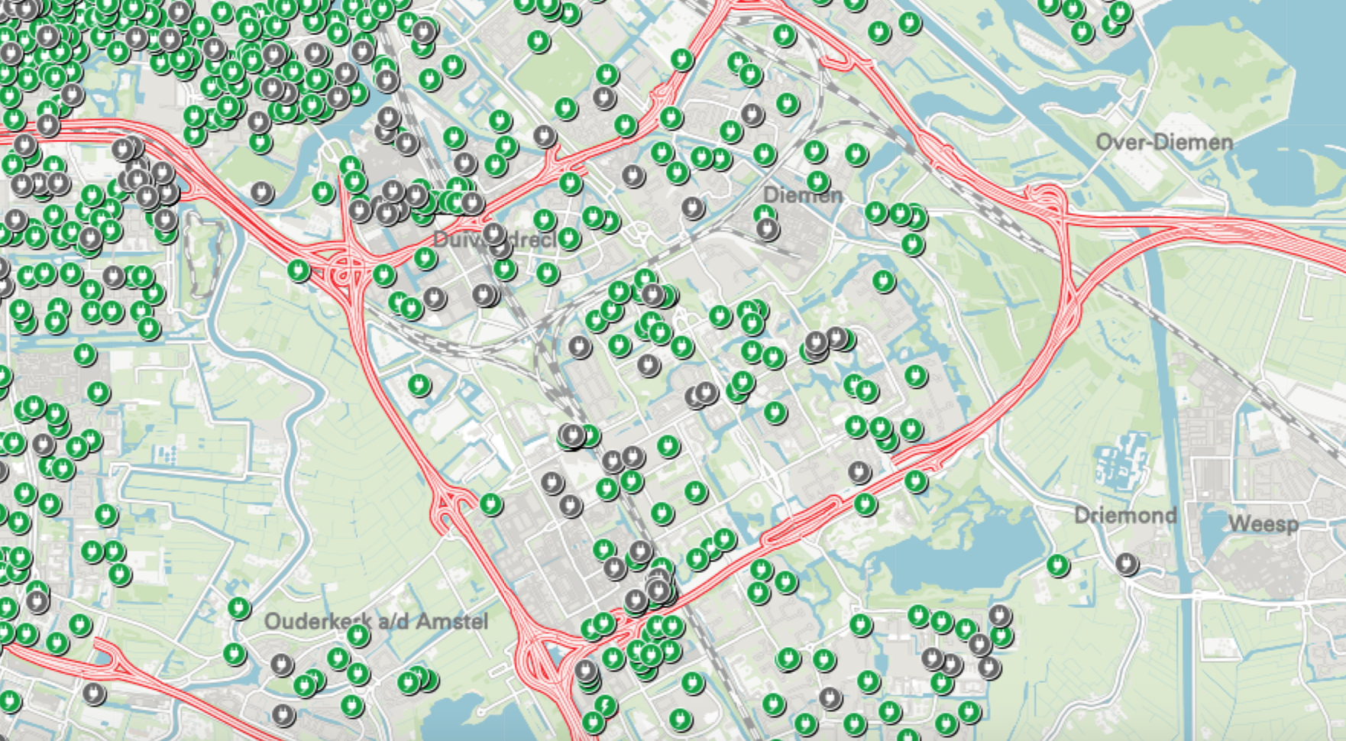
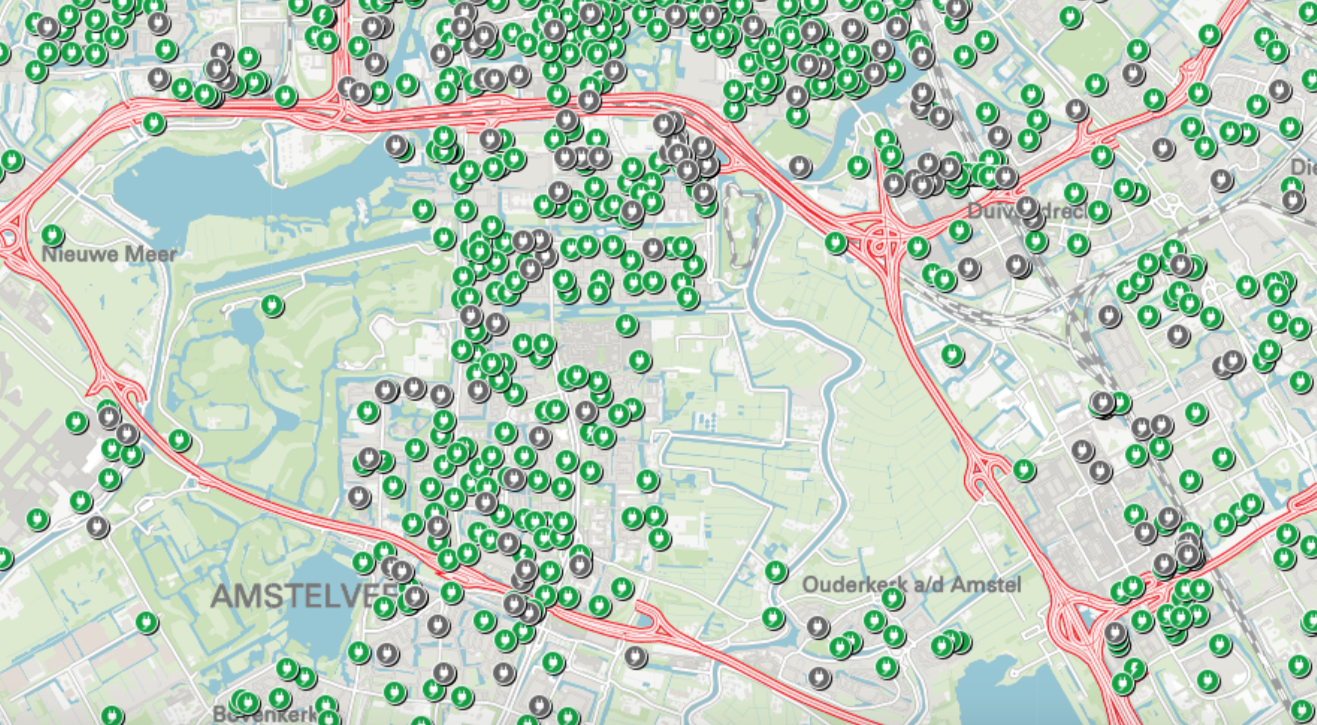
Data source: https://data.amsterdam.nl/data/?modus=kaart&lagen=opldp-slpb%3A1%7Copldp-slpnb%3A1%7Copldp-nlpb%3A1%7Copldp-nlpnb%3A1&legenda=true&zoom=8

Slide 3
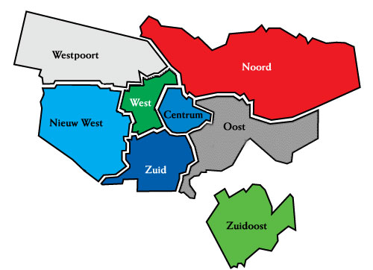
WESTPOORT
NOORD
WEST
CENTRUM
NIEUW WEST
OOST
ZUID
ZUIDOOST

Slide 4

Are charging stations put on the right spot?
Stadsdeel | Number of charging stations
Centrum | 6
West | 4
Westpoort | 1
Nieuw west | 3
Zuid | 7
Oost | 4
Zuidoost | 3
Noord | 3
SCALE:
7 most
6 more
5 much
4 average
3 little
2 less
1 least

Slide 5
Are charging stations put on the right spot?
1 – looking at current locations of charging stations
2 – looking at relative population growth per stadsdeel

Slide 6
Data source: https://data.amsterdam.nl/datasets/zoek/?term=bbga

Slide 7
Are charging stations put on the right spot?
SCALE
Average growth population:
1 highest
2 1,5% - 2%
3 1% - 1,5%
4 0,5% - 1%
5 0% - 0,5%
6 -0,5% - 0%
7 lowest
Stadsdeel | Number of charging stations | Average population growth (2016-2020)
Centrum | 6 | 5 (0,21%)
West | 4 | 4 (0,64%)
Westpoort | 1 | 7 (-10,52%)
Nieuw west | 3 | 2 (1,75%)
Zuid | 7 | 4 (0,68%)
Oost | 4 | 1 (2,00%)
Zuidoost | 3 | 3 (1,22%)
Noord | 3 | 2 (1,68%)

Slide 8
Are charging stations put on the right spot?
1 – looking at current locations of charging stations
2 – looking at relative population growth per stadsdeel
3 – looking at growth in number of companies per 1000 inhabitants per stadsdeel

Slide 9
Data source: https://data.amsterdam.nl/datasets/zoek/?term=bbga

Slide 10
Are charging stations put on the right spot?
SCALE
Average growth of companies per 1000 inhabitants:
1 highest
2 3% - 4%
3 2% - 3%
4 1% - 2%
5 0%- 1%
6 -1% - 0%
7 lowest
Stadsdeel | Number of charging stations | Average population growth (2016-2020) | Average growth in number of companies per 1000 inhabitants (2015-2019)
Centrum | 6 | 5 (0,21%) | 4 (1,54%)
West | 4 | 4 (0,64%) | 5 (0,37%)
Westpoort | 1 | 7 (-10,52%) | 1 (10,90%)
Nieuw west | 3 | 2 (1,75%) | 4 (1,11%)
Zuid | 7 | 4 (0,68%) | 2 (3,20%)
Oost | 4 | 1 (2,00%) | 7 (-0,73%)
Zuidoost | 3 | 3 (1,22%) | 2 (3,16%)
Noord | 3 | 2 (1,68%) | 4 (1,96%)

Slide 11
Are charging stations put on the right spot?
1 – looking at current locations of charging stations
2 – looking at relative population growth per stadsdeel
3 – looking at growth in number of companies per 1000 inhabitants per stadsdeel

Slide 12
Are charging stations put on the right spot?
Stadsdeel | Number of charging stations | Average population growth (2016-2020) | Average growth in number of companies per 1000 inhabitants (2015-2019) | Attention area?
Centrum | 6 | 5 (0,21%) | 4 (1,54%) | No (15)
West | 4 | 4 (0,64%) | 5 (0,37%) | No (13)
Westpoort | 1 | 7 (-10,52%) | 1 (10,90%) | Unclear (9)
Nieuw west | 3 | 2 (1,75%) | 4 (1,11%) | Yes (9)
Zuid | 7 | 4 (0,68%) | 2 (3,20%) | No (13)
Oost | 4 | 1 (2,00%) | 7 (-0,73%) | No (12)
Zuidoost | 3 | 3 (1,22%) | 2 (3,16%) | Yes (8)
Noord | 3 | 2 (1,68%) | 4 (1,96%) | Yes (9)
Low in total points means: currently low in charging stations, high population growth and high growth in number of
companies per 1000 inhabitants SO more charging stations needed.

